Slide 1

WEATHER PREDICTION
.

Slide 2
STATISTICAL MACHINE LEARNING
Preetham Kasarla - 2103A52185
Mahanth.P - 2103A52190
Radhakrishna.J - 2103A52192
Under the guidance of
MR.D.Ramesh
Asst.professor
CS and AI&ML

Slide 3
AGENDA
Introduction
Data set
Method
Explanation
Graphs
Conclusion

Slide 4
INTRODUCTION
The Machine Learning Model that we are working on is WEATHER PREDICTION. The remarkable improvement in the quality of weather forecasts is one of the great successes of environmental science in the 20th century, which continues at a sustained pace at the beginning of the 21st century. This is due to the progress of numerical prediction systems and the increasing number and variety of observations of the state of the atmosphere and related media (ocean, soils, vegetation, cryosphere), including observations from Earth observation satellites. The rapid development of supercomputers has been one of the keys to this success, which has also required significant scientific work. The "weather prediction dataset" is a novel tabular dataset that was specifically created for teaching machine learning and deep learning to an academic audience. The dataset contains intuitively accessible weather observations from 18 locations in Europe. It was designed to be suitable for a large variety of different training goals, many of which are not easily giving way to unrealistically high prediction accuracy.

Slide 5
There are various parameters that we need to take into consideration to predict the weather of a day .
We have chosen classification method to predict the weather
The dataset chosen is labelled hence it has y values which are dependent on the x values.
The above dataset comes under supervised learning .
Classification:
Systematic arrangement in groups or categories according to established criteria specifically is classification.
ABOUT DATASET:
For this project, we have obtained my dataset from Kaggle. This dataset contains 1463 rows of data and 6 columns(features)that we could focus onto build our prediction model i.e., we use 14 attributes to predict the weather.

Slide 6
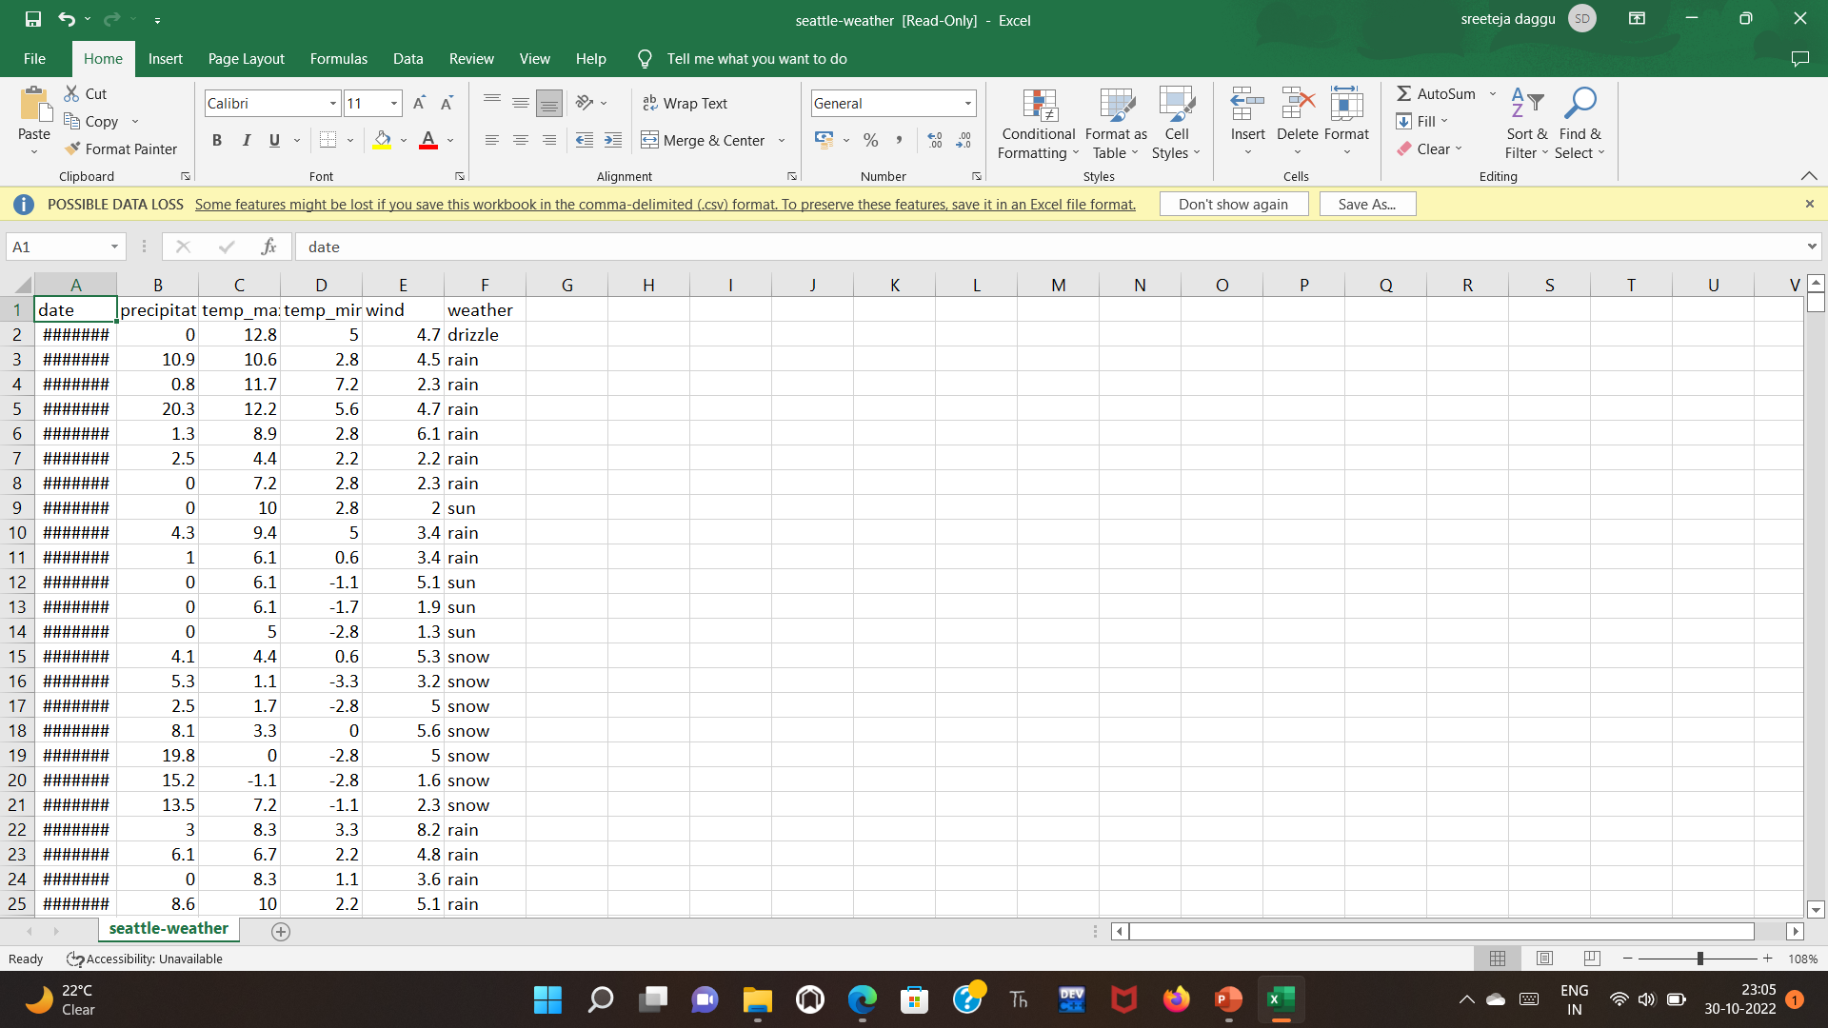
DATA SET
Annual revenue growth

Slide 7
METHOD USED FOR PREDICTION
This dataset includes labelled values hence it is considered as supervised learning
Under supervised learning the above mentioned dataset comes under classification
In the above data set y values are dependent x values are independent values.
Y values in the dataset are classified between drizzle, rain , sun, snow.
In the data set y values are dependent on the x values i.e. maximum temperature, minimum temperature, precipitation and Wind.

Slide 8
CLASSIFICATION
Here, we have taken classification to predict the weather .As we must predict the weather , weather it is drizzly, sun, snow , rain.
Systematic arrangement in groups or categories according to established criteria specifically is classification.
Here we are classifying the weather between drizzly , sun , snow, rain .so, we are considering it as classification

Slide 9
TARGET VARIABLES
 | WEATHER | LABELLED
 | DRIZZLE | 1
 | RAIN | 2
 | SUN | 3
 | SNOW | 4

Slide 10
LOGESTIC REGRESSION:
In statistics, the logistic model is a statistical model that models the probability of an event taking place by having the log-odds for the event be a linear combination of one or more independent variables. In regression analysis, logistic regression is estimating the parameters of a logistic model. Formally, in binary logistic regression there is a single binary dependent variable, coded by an indicator variable, where the two values are labeled "0" and "1", while the independent variables can each be a binary variable or a continuous variable .The corresponding probability of the value labeled "1" can vary between 0 and 1, hence the labeling; the function that converts log-odds to probability is the logistic function, hence the name. The unit of measurement for the log-odds scale is called a logit, from logistic unit, hence the alternative names.

Slide 11
ADVANTAGES AND DISADVANTAGES:
Being able to predict and forecast the weather also allows for data to be gathered to build up a more detailed picture of a nation's climate, and trends within it. precipitation, barometric pressure, temperature, and relative humidity detectors in one instrument.
Radar technology has been around for the longest time now. It is applicable in a variety of industries and its usage spans a number of applications. One such application is in the weather. A weather radar is mostly used in the collection of data regarding the weather and its components.
Weather radar has the limitation of not being able to detect fog. This creates a gap in weather forecasting where an area that is likely to receive fog is not properly profiled.
Weather radar is not known to detect wind independently unless with the use of additional remote sensing. This also creates a gap weather forecasting.

Slide 12
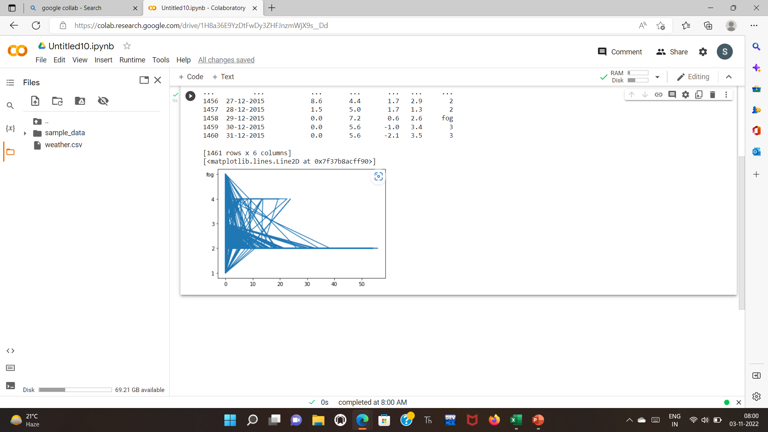
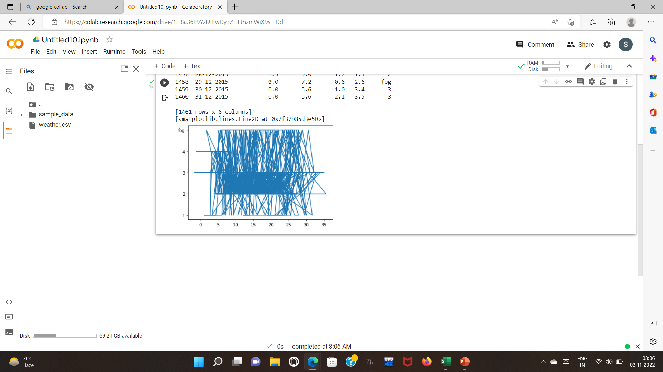
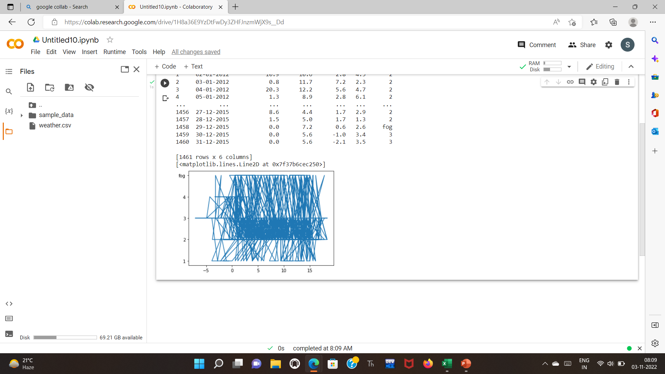
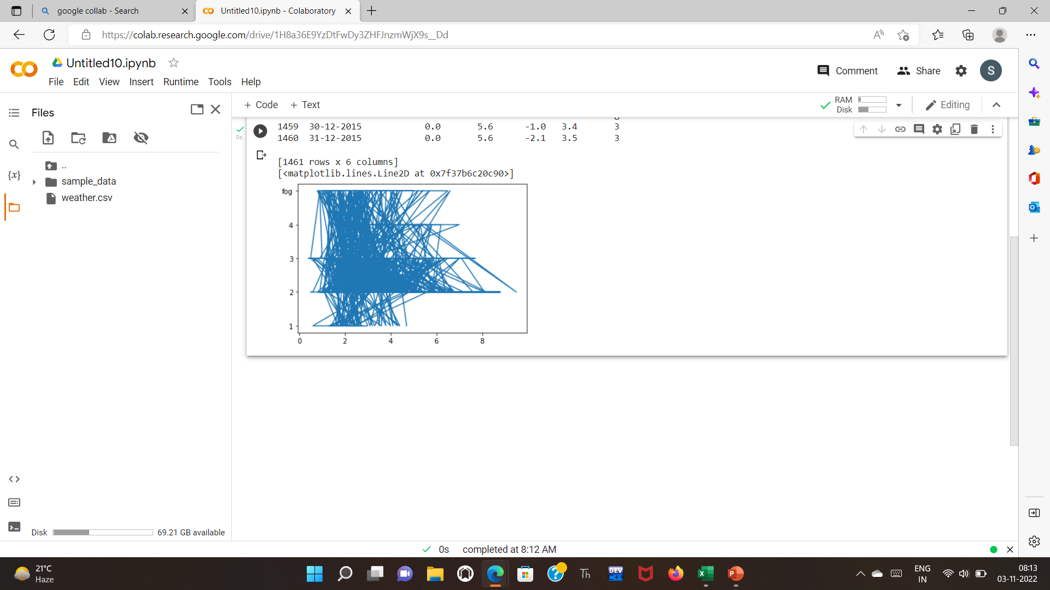
X1= d[‘precipitation’] Y= d[‘weather’]
X= d[‘temp_max’] Y= d[‘weather’]
X3= d[‘temp_min’] Y= d[‘weather’]
X4= d[‘wind’] Y= d[‘weather’]

Slide 13
TYPE OF MACHINE LEARNING USED
Since the data set contains dependent variable, that is weather, the data set falls under supervised machine learning in which parametric method is used and the algorithm used here is linear regression, ridge regression and lasso regression.
Here rain, sun, drizzle and snow are dependent variables.
Today, we face many problems around applying descriptive Machine Learning in Hazard detection, especially to storm tracking. Before the advancement of technology, weather forecasters depend upon satellites, atmospheric conditions with less accuracy.

Slide 14
CONCLUSION
So, from the above table (accuracy), we can predict that the linear regression model has shown accurate results for the model. We have used linear regression model and KNN methods to get 95.32% accuracy rate in linear regression.
Systematic arrangement in groups or categories according to established criteria specifically is classification.
Here we are classifying whether the weather is drizzly , sun , snow, rain .so, we are considering it as classification
We are using KNN type of classification because The KNN algorithm can compete with the most accurate models because it makes highly accurate predictions. Therefore, you can use the KNN algorithm for applications that require high accuracy.

